Slide 1
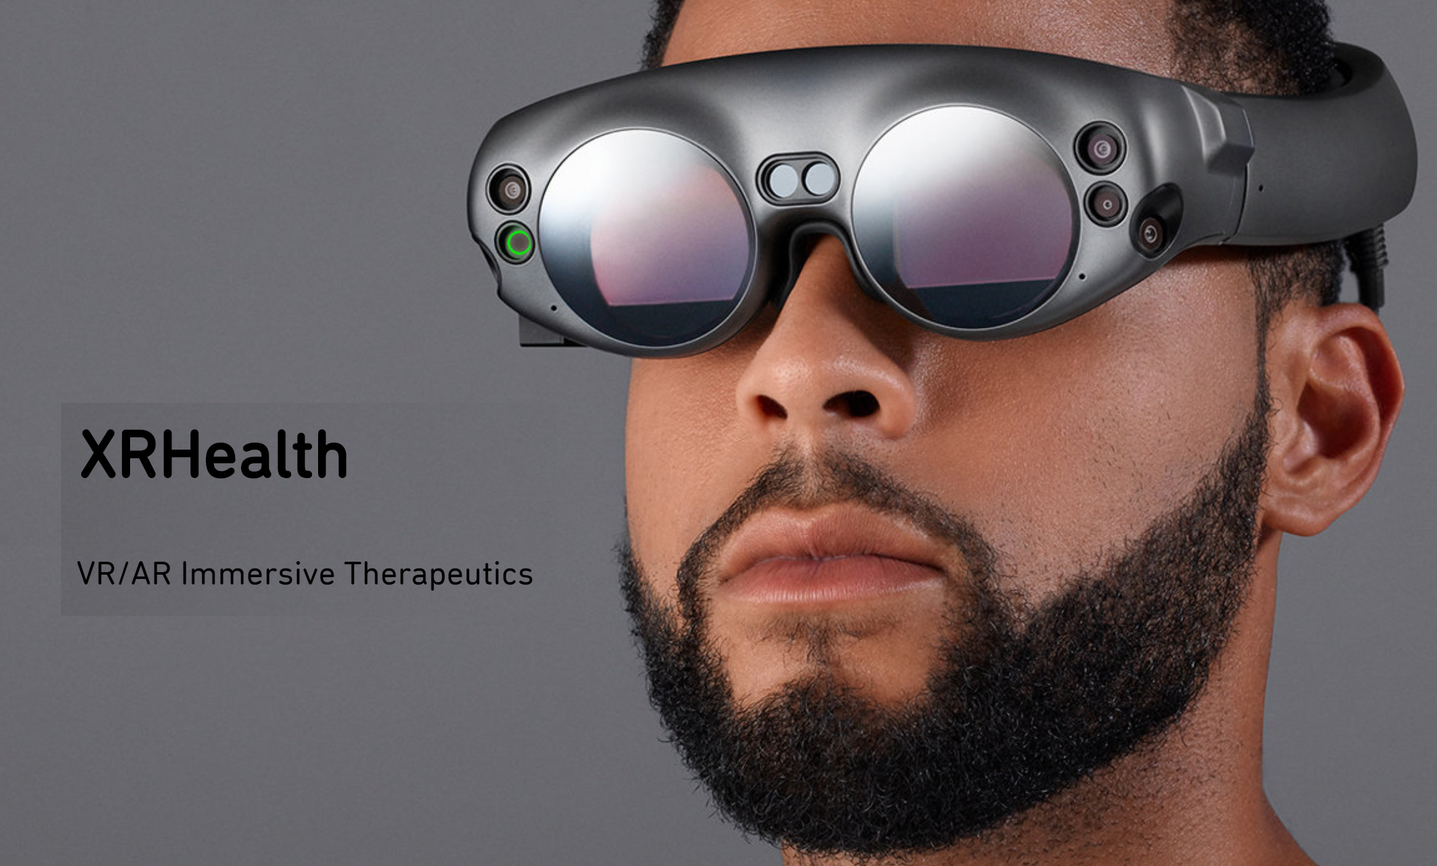
Virtual Reality
is seeing… believing & achieving?
Acknowledgements
Beate Dejaco MSc
Bart Staal PhD
Niamh Brady MSc
Karen McCreesh PhD
Joe McVeigh PhD
@JeremyLewisPT

Slide 2
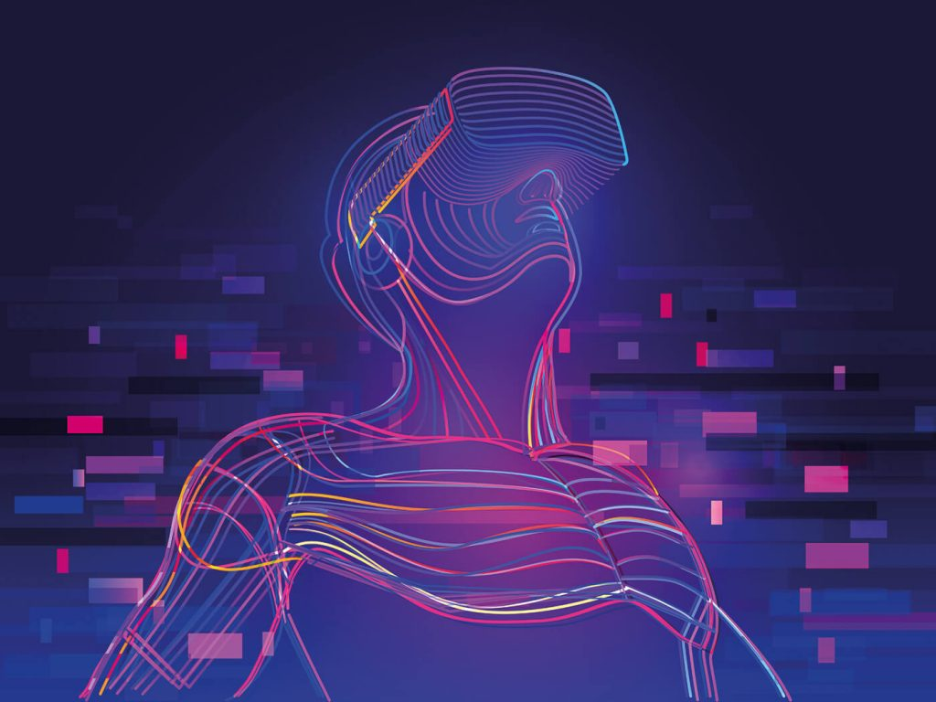
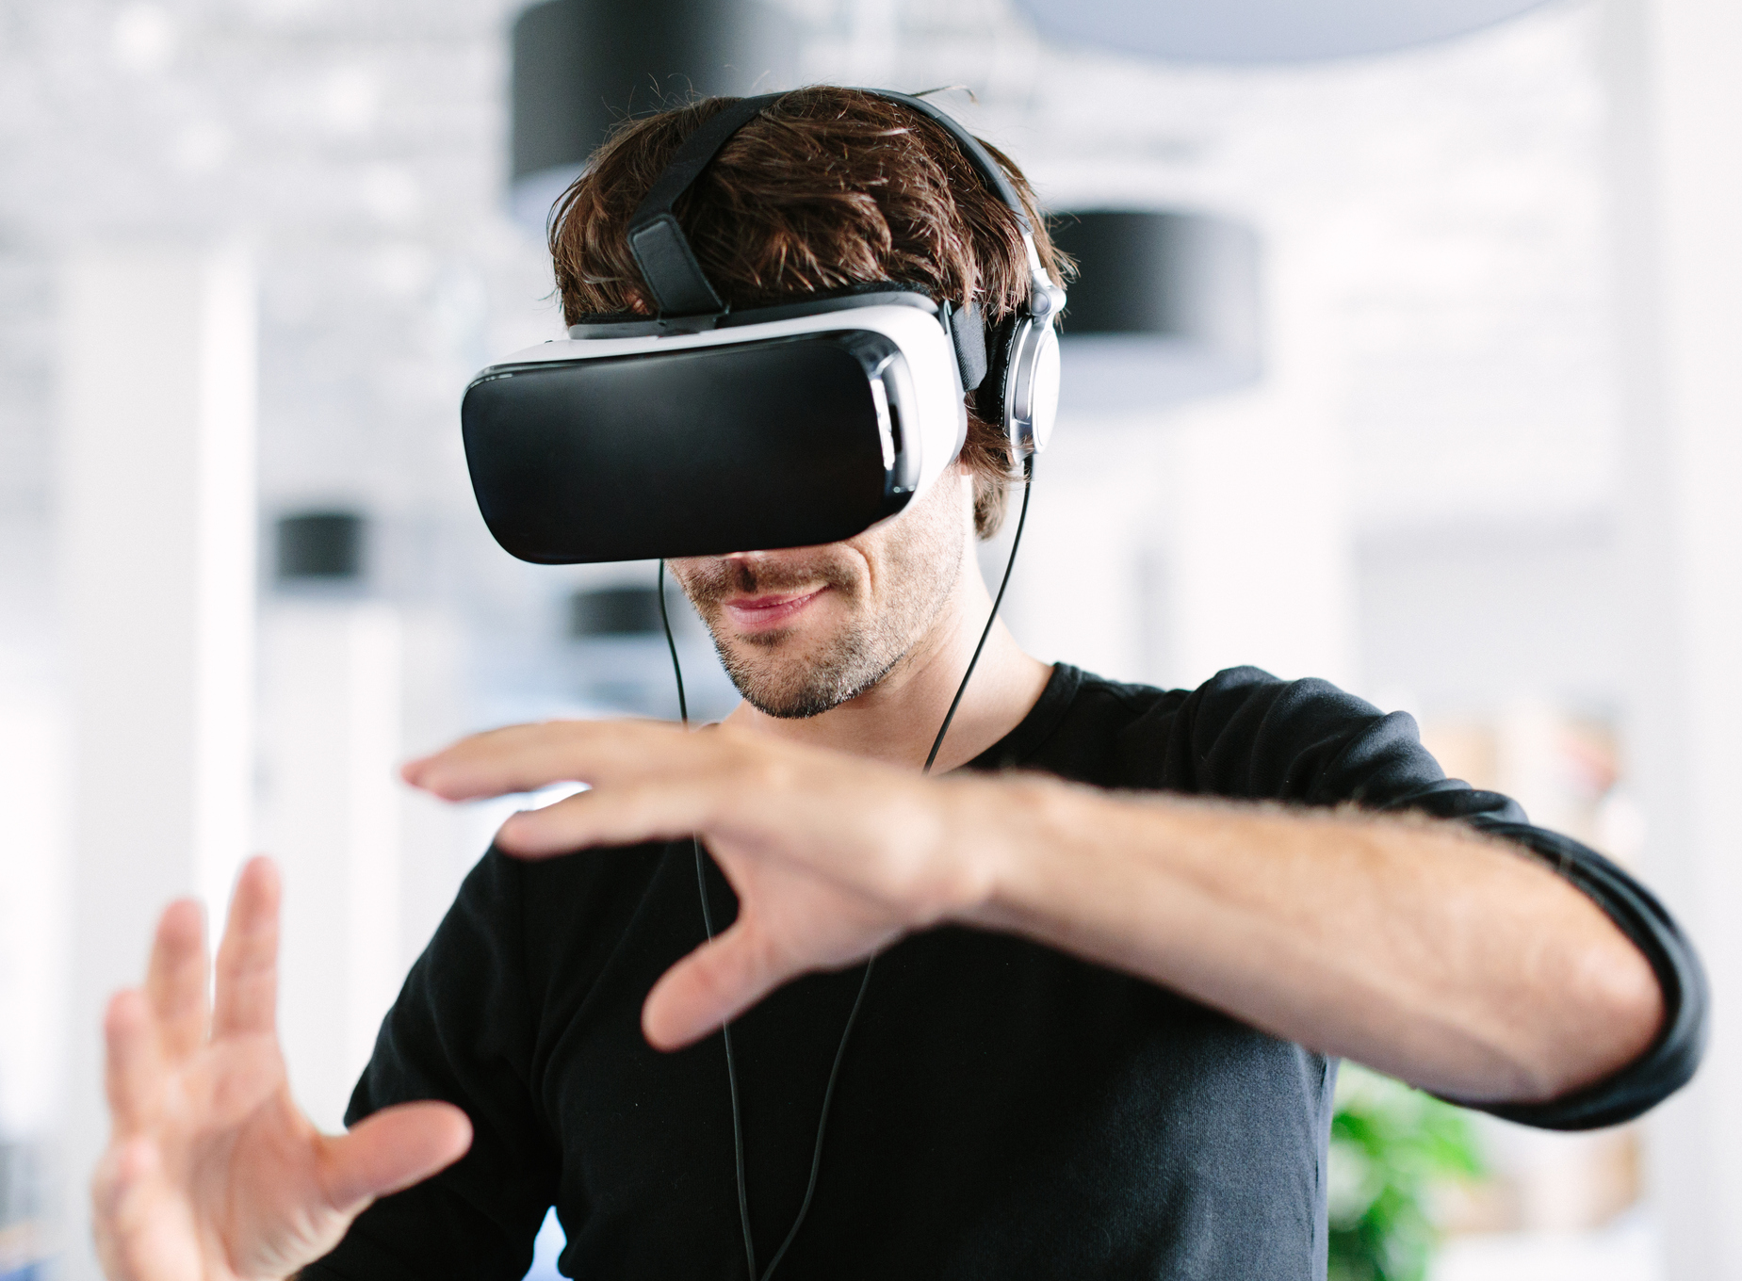
Summary
VR has great potential in MSK shoulder pain to:
measure single & complex ROM
personalise treatment
motivate patients
increase compliance
document progress
▼ pain and ▲ function
@JeremyLewisPT

Slide 3
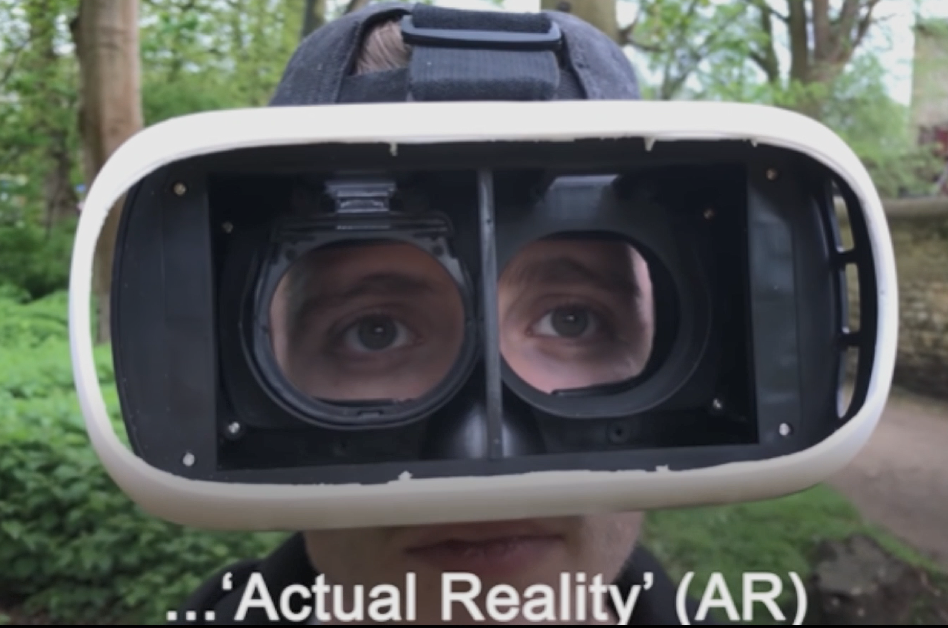
Summary
But we currently don’t know if
VR is any better than Actual Reality!
@JeremyLewisPT

